Slide 1
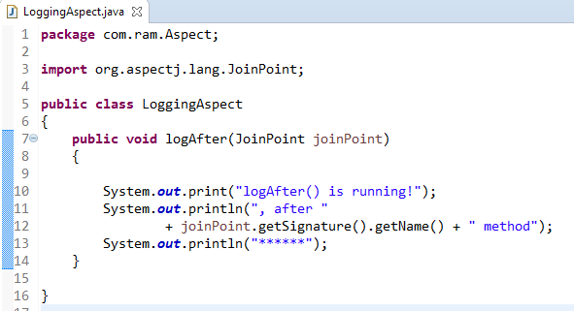
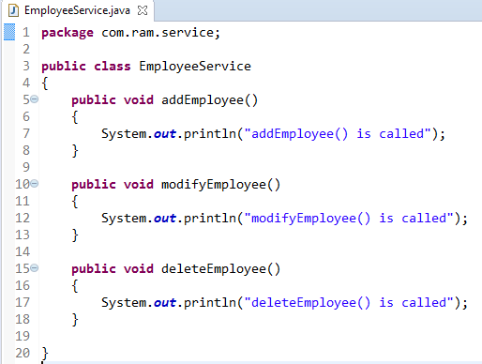
Spring AOP + AspectJ in XML configuration - AspectJ <aop:after> = @After
@After declares the after advice. it is executed after the actual method call. If method returns a value, it is executed after returning value.
method
@After
2
1

Slide 2
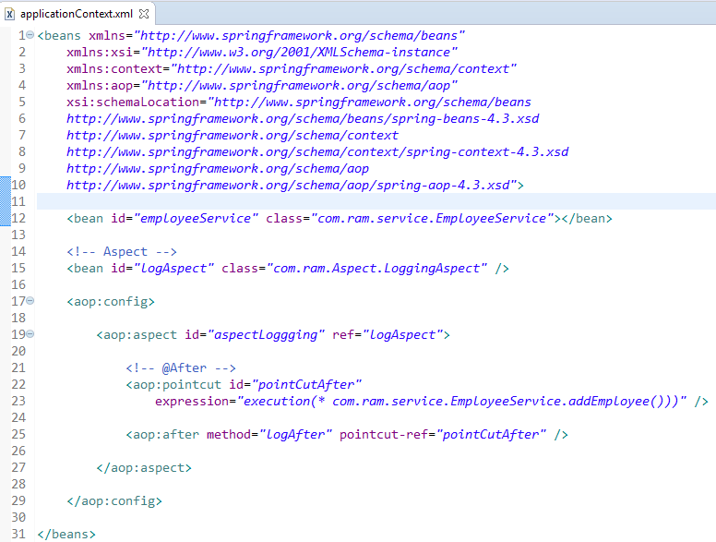
AspectJ <aop:after> = @After

Slide 3
